Slide 1
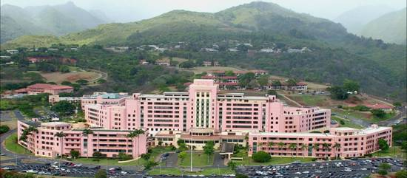
BASIC FOOD HANDLER’S COURSE
Environmental Health Section
Department of Public Health
Tripler Army Medical Center

Slide 2
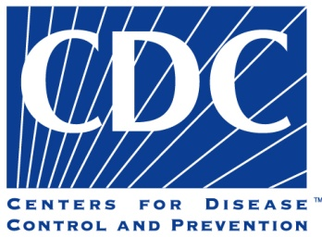
Introduction
CDC estimates that each year, roughly 1 in 6 Americans (or 48 million people) get sick.
After combining the estimates for the major known pathogens and the unspecified agents, the overall annual estimate of the total burden of disease due to contaminated food consumed in the United States is 47.8 million illnesses, 127,839 hospitalizations, and 3,037 deaths.
Foodborne Illness Outbreak :
Incident occurs when a two or more people consume the same contaminated food, from the same source, and come down with the same illness.
http://www.cdc.gov/foodborneburden/questions-and-answers.html

Slide 3
OVERVIEW
Proper Personal Hygiene
Foodborne Illnesses
Thermometers
Storage
Food Service
Cleaning it up

Slide 4
SECTION 1
Proper Personal Hygiene

Slide 5

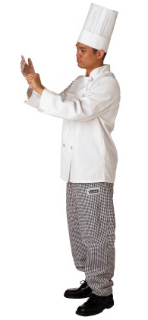
Good personal hygiene includes:
  Maintaining personal cleanliness
  Wearing proper and clean attire
  Following hygienic hand practices
  Avoiding unsanitary habits and actions
  Maintaining good health
  Reporting illnesses
Notes:
Instructor Notes
Maintaining personal cleanliness means bathing or showering before work.
Foodhandlers must also keep their hair clean, since oily, dirty hair can harbor pathogens.

Slide 6
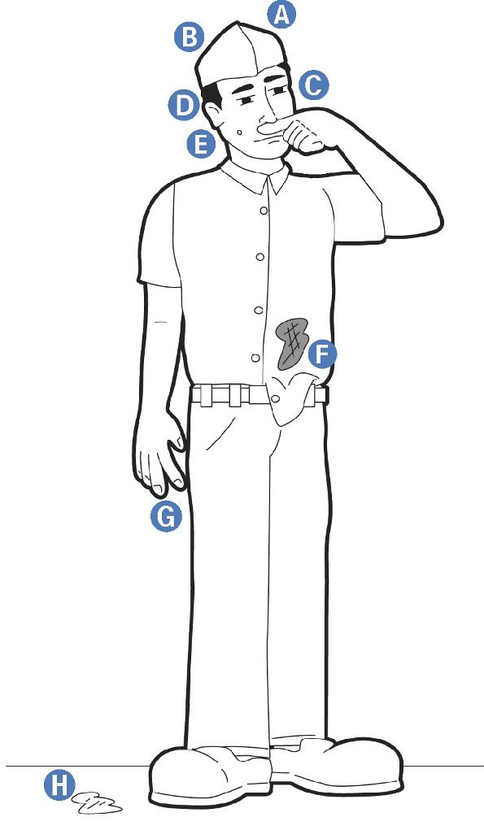
How Food Handlers Contaminate Food
A
Improper or no hair restraints
Running fingers/touching
hair
Wiping or touching
the nose
Rubbing and touching
your ears
B
E
Touching a pimple or
open sore
Wearing a dirty uniform
Coughing or sneezing into
the hand
Spitting in the establishment
C
F
G
D
H
Notes:
Instructor Notes
Thirty to 50 percent of healthy adults carry Staphylococcus aureus in their nose, and about 20 to 35 percent carry it on their skin.
If these microorganisms contaminate food, the consequences can be severe. To prevent this, foodhandlers must avoid the behaviors indicated in the slide.

Slide 7

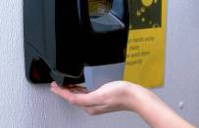


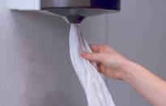
Hand Washing
The whole process should take 15 - 20 seconds
1
Wet hands with running water as hot as you can comfortably stand (at least 100°F/38°C)
2
Apply soap
3
Vigorously scrub hands and exposed areas of arms for fifteen seconds. Clean under fingernails and in between fingers.
Dry hands and arms with a single-use paper towel or warm-air hand dryer. Use a paper towel to turn off the faucet and open door to bathroom.
4
Rinse thoroughly under running water.
5
5
Notes:
Instructor Notes
Handwashing is the most critical aspect of personal hygiene. As a manager, it is your responsibility to train foodhandlers on when and how to properly wash hands and then monitor them.
When washing hands, you should apply enough soap to build up a good lather. Lather well beyond the wrists, including the exposed portions of the arms. Vigorously scrub hands and arms for ten to fifteen seconds. Clean under fingernails and between fingers.
After drying hands, turn off the faucet using a single-use paper towel, if available. When in a restroom, use a paper towel to open the door.

Slide 8
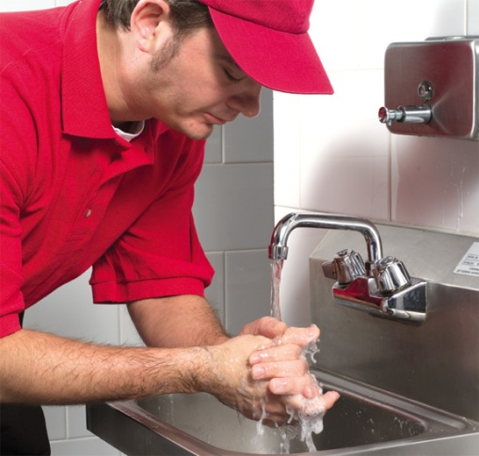
When to Wash Hands
Food handlers must wash their hands after:
  Using the restroom
  Handling raw meat, poultry, and
  fish (before and after)
  Touching the hair, face, or body
  Sneezing, coughing, or using
  a tissue
  Smoking, eating, drinking, or chewing
  gum or tobacco
  Handling money

Slide 9
When to Wash Hands (con’t.)
Food handlers must wash their hands after:
  Handling chemicals that might
  affect food safety
  Taking out garbage
  Clearing tables
  Touching soiled clothing
  Touching anything else that may contaminate hands, such as un-sanitized equipment, work surfaces, or washcloths.
  WHEN IN DOUBT, WASH THEM!

Slide 10
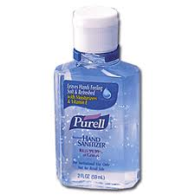
Hand Antiseptics
  Must comply with Food and Drug Administration standards.
  Must never be used in place of hand washing.
  Do not use scented hand sanitizer.
Notes:
Instructor Notes
Hand antiseptics reduce microorganisms on the skin. They are available in liquid and gel form.
If hand antiseptics are used, foodhandlers should not touch food or food-preparation equipment until the antiseptic has dried.
Discuss the How This Relates To Me on page 4-8 in ServSafe Essentials.

Slide 11
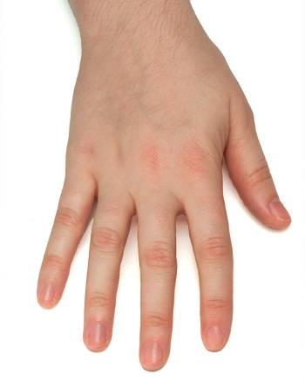
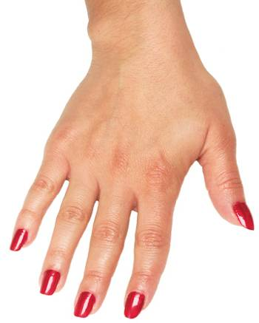
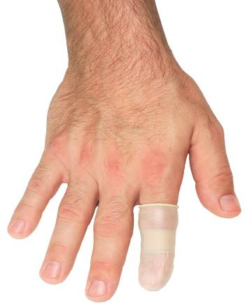
Hand Maintenance
Keep fingernails
short and clean
Bandage cuts and cover bandages using finger cots and gloves.
Do not wear false
nails, nail adornments, or nail polish
Notes:
Instructor Notes
Long, false, and acrylic nails should not be worn because they may be difficult to keep clean. Some jurisdictions allow false nails if single-use gloves are worn.
Nail polish can disguise dirt under nails and may flake off into food. Some jurisdictions allow polished nails if single-use gloves are worn.
Cover all hand cuts and sores with clean bandages. If there is a bandage on the hand, then gloves or a finger cot should be worn at all times to protect the bandage and prevent it from falling off into food.
A foodhandler with infected wounds may need to be moved to a nonfoodhandling position until it heals. The new position should not involve contact with food or food-contact surfaces.
Discuss the How This Relates To Me on page 4-10 in ServSafe Essentials.

Slide 12
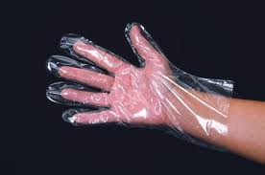
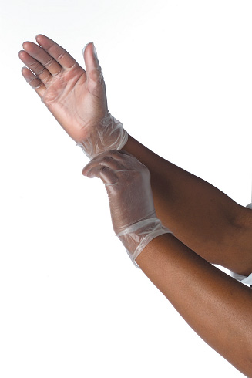
Gloves
Gloves used for handling food:
  Do NOT blow into the gloves
  Must NEVER be used in place of hand washing
  Are for SINGLE use only
  Should be right for the task
  Must be safe, durable, and clean
  Must fit properly
  Must be used properly
  Do NOT handle money while wearing gloves
Notes:
Instructor Notes
Gloves can help keep food safe by creating a barrier between hands and food.
Buy disposable gloves. Gloves used to handle food are for single use only. They should never be washed and reused.
Buy the right glove for the task. Long gloves, for example should be used for mixing salads.
Provide a variety of glove sizes. Gloves that are too big will not stay on the hand, and those that are too small will tear or rip easily.
Consider latex alternatives for employees who are sensitive to the material.
Focus on safety, durability, and cleanliness. Make sure you purchase gloves specifically designed for food contact, which include gloves bearing the NSF International certification mark.

Slide 13
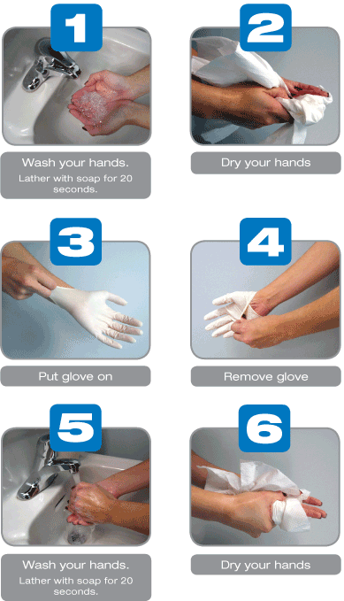
Hygienic Hand Practices: Gloves
When to Change Gloves
  As soon as they become
  soiled or torn
  Before beginning a different
  task
  At least every four hours during continual use and more often when necessary
  After handling raw meat and before handling cooked or ready-to-eat food
***Hands must be washed before placing on gloves or in between changing gloves. During moments of high customer volume, FDA approved hand sanitizer can be utilized but once customer traffic dies down, hands will be washed with soap and water.
Notes:
Instructor Notes
Hands must be washed before putting on gloves and when changing to a new pair.
When removing gloves, grasp them at the cuff and peel them off inside out over the fingers, without making contact with the palm and fingers.
Discuss the How This Relates To Me on page 4-11 in ServSafe Essentials.

Slide 14
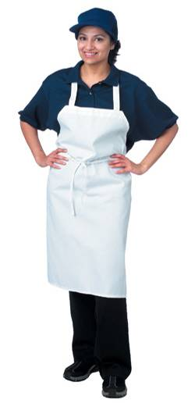
Proper Work Attire
Food handlers should:
A
Wear a clean hat or other
hair restraint
Wear clean clothing
Remove aprons when leaving
food-preparation areas (if applicable)
Remove jewelry from hands and arms
Wear appropriate and clean closed-toe shoes
A
B
B
C
D
C
D
E
E
Notes:
Instructor Notes
A foodhandler’s attire plays an important role in the prevention of foodborne illness.
A hair restraint will keep hair away from food and keep foodhandlers from touching it. Foodhandlers with facial hair should also wear a beard restraint.
Foodhandlers must remove jewelry from hands and arms prior to preparing or serving food and when working around food-preparation areas. Jewelry may contain microorganisms and may tempt foodhandlers to touch it. Remove rings (except a plain band); bracelets (including medical information jewelry); and watches. Your company may also require the removal of other types of jewelry as well.
It is important to check with your local regulatory agency for work attire requirements in your jurisdiction.
These requirements should be reflected in written policies that are consistently monitored and enforced. All applicants should be made aware of these policies prior to employment.
Discuss the How This Relates To Me on page 4-13 in ServSafe Essentials.

Slide 15

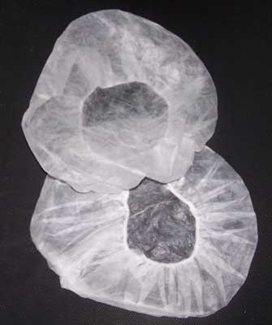
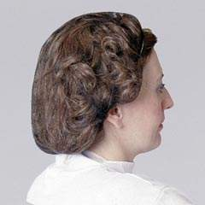
HAIR RESTRAINTS
Keeps hair from entering food.
Keeps hands from touching hair.
If wearing a ponytail with ball cap, the ponytail must not stick out of the hole of the ball cap. It must be either tucked under the cap or a hair net must be worn under the ball cap.
IMPROPER WEAR!
Correct wear!
Effective hair restraints include hair nets & hats.

Slide 16
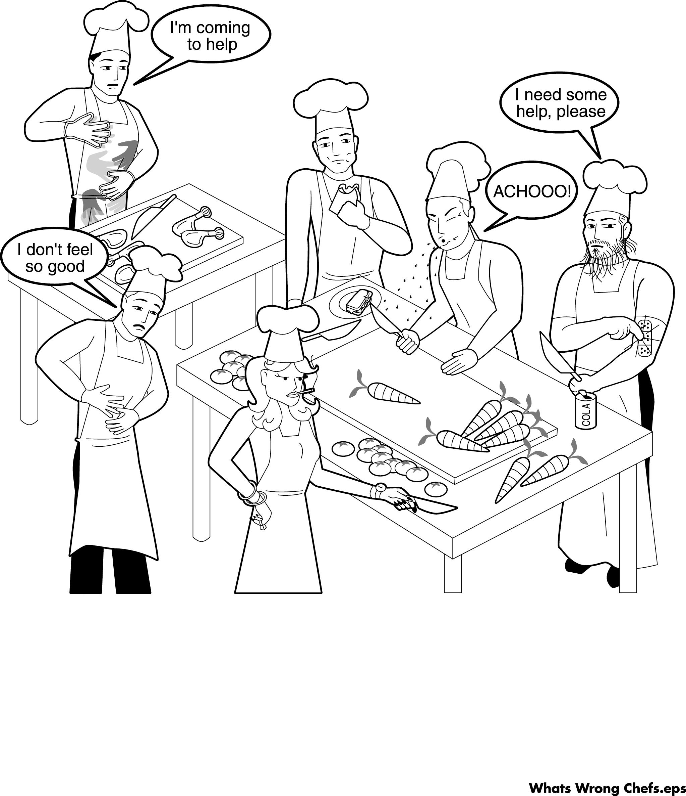
What is wrong with this?
Notes:
Dirty hands
Sick Employee
Smoking in the Kitchen
Unauthorized Jewelry
Open Drink Container
Scratching his band aid
Beard with no restraint
Sneezing on the food
Eating in the food prep area

Slide 17
SECTION 2
Foodborne Illnesses

Slide 18
A Few Foodborne Pathogens
Bacillus cereus– A variety of foods, particularly rice and leftovers, as well as sauces, soups, and other prepared foods that have sat out too long at room temperature; http://www.foodsafety.gov/poisoning/causes/bacteriaviruses/bcereus/
Campylobacter: Raw and undercooked poultry, unpasteurized milk, contaminated water. http://www.foodsafety.gov/poisoning/causes/bacteriaviruses/campylobacter/index.html
Clostridium botulinum–Infants: Honey, home-canned vegetables and fruits, corn syrup. Children and adults: Home-canned foods with a low acid content, improperly canned commercial foods, home-canned or fermented fish, herb-infused oils, baked potatoes in aluminum foil, cheese sauce, bottled garlic, foods held warm for extended periods of time. http://www.foodsafety.gov/poisoning/causes/bacteriaviruses/botulism/index.html

Slide 19
A Few Foodborne Pathogens(con’t.)
Clostridium perfringens: Beef, Poultry, Gravy; often occur when foods are prepared in large quantities and are then kept warm for a long time before serving. That’s why outbreaks of these infections are usually linked to institutions (such as hospitals, school cafeterias, prisons, and nursing homes) or events with catered food. http://www.foodsafety.gov/poisoning/causes/bacteriaviruses/cperfringens/index.html
E. Coli: Contaminated food, especially undercooked ground beef, unpasteurized (raw) milk and juice, soft cheeses made from raw milk, and raw fruits and vegetables (such as sprouts); Contaminated water, including drinking untreated water and swimming in contaminated water; Animals and their environment: particularly cows, sheep, and goats. If you don’t wash your hands carefully after touching an animal or its environment, you could get an E. coli infection; Feces of infected people. http://www.foodsafety.gov/poisoning/causes/bacteriaviruses/ecoli/index.html
Lysteria: Ready-to-eat deli meats and hot dogs; Refrigerated pâtés or meat spreads; Unpasteurized (raw) milk and dairy products; Soft cheese made with unpasteurized milk, such as queso fresco, Feta, Brie, Camembert; Refrigerated smoked seafood; Raw sprouts http://www.foodsafety.gov/poisoning/causes/bacteriaviruses/listeria/index.html

Slide 20
A Few Foodborne Pathogens (con’t.)
Salmonella: Contaminated eggs, poultry, meat, unpasteurized milk or juice, cheese, contaminated raw fruits and vegetables (alfalfa sprouts, melons), spices, and nuts. http://www.foodsafety.gov/poisoning/causes/bacteriaviruses/salmonella/index.html
Shigella: Contaminated food or water, or contact with an infected person. Foods most often associated with Shigella outbreaks are salads and sandwiches that involve a lot of hand contact in their preparation, and raw vegetables contaminated in the field. http://www.foodsafety.gov/poisoning/causes/bacteriaviruses/shigella/index.html
Staphylococcus : Foods that are made with hand contact and require no additional cooking, such as: Salads, such as ham, egg, tuna, chicken, potato, and macaroni; Bakery products, such as cream-filled pastries, cream pies, and chocolate éclairs; Sandwiches; Other sources include milk and dairy products, as well as meat, poultry, eggs, and related products. http://www.foodsafety.gov/poisoning/causes/bacteriaviruses/staphylococcus/index.html

Slide 21
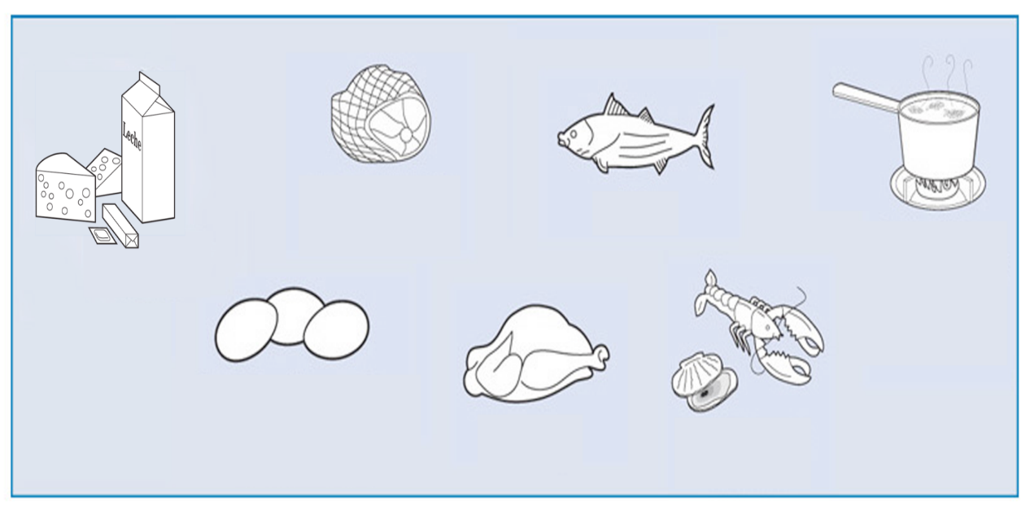
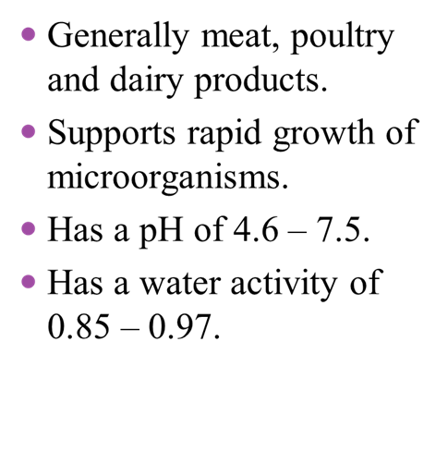
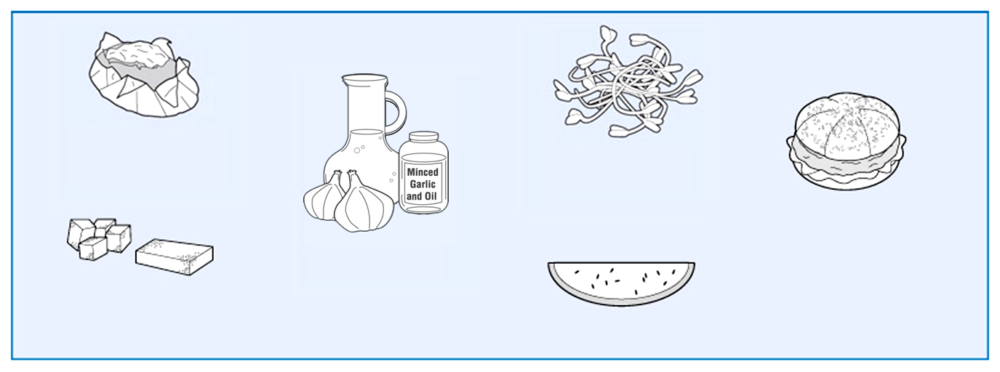






Potentially Hazardous Food
Meat: Beef, Pork,
Lamb
Fish
Heat-Treated Plant Food, such as Cooked Rice, Beans, and Vegetables
Milk and Milk
Products
Eggs (except those
treated to eliminate
Salmonella spp.)
Poultry
Shellfish and
Crustacean
Notes:
Instructor Notes
Although any type of food can be contaminated, some are better able to support the rapid growth of microorganisms than others. These items are called potentially hazardous food.

Slide 22



Factors Contributing To The Growth Of Pathogens
T-Temperature
O- Oxygen
M- Moisture
F- Food
A- Acidity
T- Time
FOOD ACIDITY TIME
TEMPERATURE OXYGEN MOISTURE

Slide 23


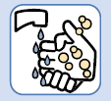

How Food Becomes Unsafe
Time-Temperature Abuse
Cross-Contamination
Poor Personal Hygiene
Improper cleaning
and sanitizing
Notes:
Instructor Notes
Remind participants that these are factors that can be controlled through good food safety practices and policies.

Slide 24
Time-Temperature Abuse
Food has been abused:
  Any time it has been allowed to remain too long at temperatures favorable for the growth of food-borne microorganisms.
Notes:
Instructor Notes
The key to food safety lies in controlling time and temperature throughout the flow of food.
It is important to establish standard operating procedures that focus on this area.

Slide 25
MINIMUM COOKING TEMPERATURES
Eggs (made to order) 145 °F (63 °C)
Fish 145 °F (63 °C)
Beef 145 °F (63 °C)
Ground beef 155 °F (66 °C)
Pork 155 °F (66 °C)
Eggs (batch cooked) 155 °F (66 °C)
Poultry 165 °F (74 °C)
Stuffed Meats 165 °F (74 °C)
Dressing 165 °F (74 °C)
Note: Foods with higher cooking temperatures will be stacked below foods with lower cooking temperatures.

Slide 26
Temperature Danger Zone (TDZ)
** Between 41° - 135° F **
PHFs THAT HAVE BEEN MAINTAINED AT UNSAFE PRODUCT TEMPERATURES (I.E., TEMPERATURE DANGER ZONE) FOR GREATER THAN FOUR HOURS CUMULATIVE TIME (FROM PREPARATION TO SERVING) WILL BE CONSIDERED ADULTERATED AND WILL BE DISCARDED AS FOOD WASTE.

Slide 27
Cross-Contamination
Cross-contamination - the transfer of a harmful substance from one food to another by direct or indirect contact.
  Direct cross-contamination involves the transfer of a harmful agent from raw foods to cooked or ready-to-eat foods.
    Example of direct contact: blood from thawing ground beef dripping onto fresh produce stored on a shelf below.
  Indirect cross-contamination involves the transfer of a harmful agent to foods by hands, utensils, or equipment.
    Example of indirect contact: raw chicken prepared with a knife and cutting board and knife and cutting board are not cleaned and sanitized after use.

Slide 28
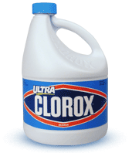

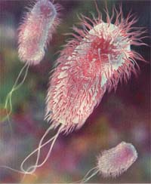
Food Protection
All food will be free of hazards.
  Physical
  Biological
  Chemical

Slide 29
Section 3: Thermometers

Slide 30
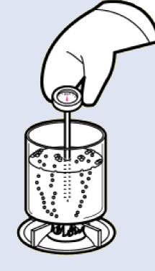
Calibrating Thermometers
Boiling-Point Method
  Bring clean tap water to a boil
  Submerge the sensing area of the
  thermometer stem or probe in the
  water for thirty seconds
  Hold the calibration nut and rotate
  the thermometer head until it reads 212°F (100°C)
Notes:
Instructor Notes
Follow these steps when using the boiling-point method to calibrate a thermometer:
1: Bring clean tap water to a boil in a deep pan.
2: Put the thermometer stem or probe into the boiling water so the sensing area is completely submerged. Wait thirty seconds, or until the indicator stops moving. Do not let the stem or probe touch the bottom or sides of the pan. The thermometer stem or probe must remain in the boiling water.
3: Hold the calibration nut securely with a wrench or other tool and
rotate the head of the thermometer until it reads 212°F (100°C). The boiling point of water is about 1°F (about 0.5°C) lower for every 550 feet (168m) you are above sea level. On some thermocouples or thermistors, it may be possible to press a reset button to adjust the readout.

Slide 31
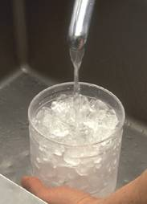
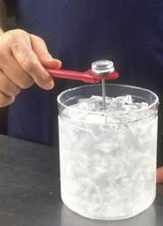
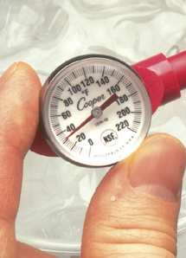
Calibrating Thermometers
Ice-Point Method
3. Hold the calibration
nut and rotate the thermometer head
until it reads 32˚F (0˚C)
1. Fill a large container with crushed ice and water
2. Submerge the thermometer stem or probe in the water for thirty seconds
Notes:
Instructor Notes
Follow these steps when using the ice-point method to calibrate a thermometer:
1: Fill a large container with crushed ice. Add clean tap water until the container is full, and then stir the mixture well.
2: Put the thermometer stem or probe into the ice water so the sensing
area is completely submerged. Wait thirty seconds, or until the indicator stops moving. Do not let the stem or probe touch the container’s bottom or sides. The thermometer stem or probe must remain in the ice water.
3: Hold the calibration nut securely with a wrench or other tool and rotate the head of the thermometer until it reads 32°F (0°C). On some thermocouples or thermistors, it may be possible to press a reset button to adjust the readout.

Slide 32
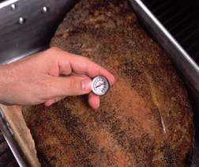
General Thermometer Guidelines
When using thermometers:
  Keep thermometers and their
  storage cases clean
  Calibrate them regularly to
  ensure accuracy
  Never use glass thermometers
  to monitor food temperature
  Insert the thermometer stem or
  probe into thickest part of product (usually the center)
  Wait for the thermometer reading to steady before recording the temperature of a food item
Notes:
Instructor Notes
Thermometers should be washed, rinsed, sanitized, and air-dried before and after each use to prevent cross-contamination. Use an approved food-contact surface sanitizing solution to sanitize them.
To ensure accuracy, thermometers should be calibrated before each shift or before each day’s deliveries. They should be recalibrated if they have been dropped, or after they have experienced a severe temperature change.
Glass thermometers should not be used since they can pose a serious danger to employees and customers if they break.
When checking the temperature of food, it is a good practice to take at least two readings in different locations, since product temperature may vary across the food portion.
When checking the internal temperature of food using a bimetallic stemmed
thermometer, insert the stem into the product so that it is immersed from the tip to the end of the sensing area. When measuring the internal temperature of thin food, such as meat or fish patties, small diameter probes should be used.
Wait at least fifteen seconds from the time the thermometer stem or probe is inserted into the food.
Remind participants that the Take It Back section in ServSafe Essentials
(page 5-18) can be used to teach important concepts from Section 5 to their employees.

Slide 33
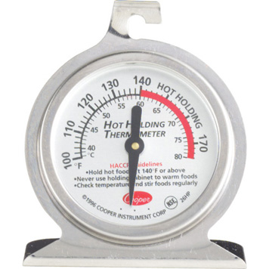
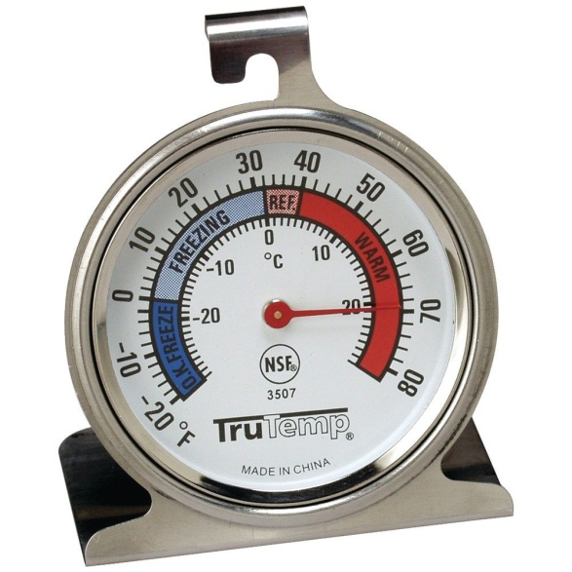
Internal Thermometers
If utilized, there should be an INTERNAL thermometer in ALL refrigeration, freezer, and hot holding units.
If utilizing a cooler with ice, having an internal thermometer will help to monitor temperatures and keep cold foods out of TDZ.

Slide 34
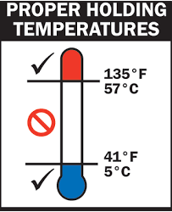
Food Temperatures
Refrigerated/Cold PHFs will be maintained at 41 degrees Fahrenheit and below.
Hot PHFs will be maintained at 135 degrees Fahrenheit and above.

Slide 35
Section 4: Storage

Slide 36
General Storage Guidelines
If there is prepared potentially hazardous, ready-to-eat food that’s not sold or consumed by the end of the predetermined fundraiser time:
  Throw it out
  Does not pertain to pre-packaged foods (such as potato chips, snack cakes, etc.)
Discard food that has passed the manufacturer’s expiration date.
Notes:
Instructor Notes
Establish a schedule to ensure that stored product is depleted on a regular basis.
For example, flour stored in plastic bins should be used within six to twelve months from the time it was placed in the bins. After that time period, the bins should be emptied, the flour discarded, and the bins cleaned and sanitized.

Slide 37
General Storage Guidelines
Transfer food between
containers properly
If food is removed from its original package:
  Put it in a clean, sanitized container
  Cover it
  Label the container with:
    The name of the food
    The original use-by or expiration date
Notes:
Instructor Notes
Never use empty food containers to store chemicals or put food in empty
chemical containers.

Slide 38
General Storage Guidelines
Keep potentially hazardous food out of the temperature danger zone
  Take out only as much food
  as can be prepared at one time
  Put prepared food away
  until needed
  Properly cool and store cooked
  food when it’s no longer needed

Slide 39
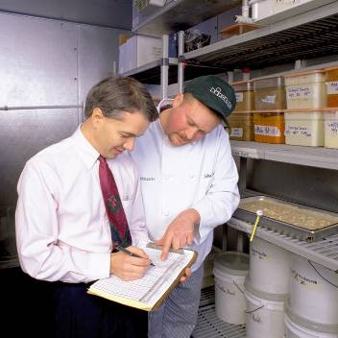
General Storage Guidelines
Check temperatures of stored food and storage containers (i.e. refrigeration units, coolers, etc.)
Notes:
Instructor Notes
Temperatures should be checked at the beginning of the shift. Many
establishments use a pre-shift checklist to guide employees through the process.

Slide 40
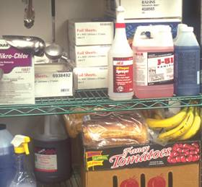
General Storage Guidelines
Store food in designated
storage areas
Do not store food:
  Near chemicals or cleaning
  supplies
  In restrooms
  In locker rooms
  In janitor closets
  In furnace rooms
  Under stairways or pipes
Never store food near chemicals or cleaning supplies
Notes:
Instructor Notes
Food can be easily contaminated in the areas indicated in the slide.

Slide 41
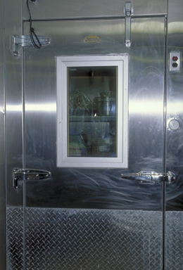
Refrigerated Storage
Refrigerated Storage
  The setting must keep the
  food at an internal temperature
  of 41°F or lower
  Slows the growth of
  microorganisms
Notes:
Instructor Notes
Refrigeration slows the growth of microorganisms and helps keep them from growing to levels high enough to cause illness.
Discuss the How This Relates to Me on Essentials page 7-5. Note that some jurisdictions allow food to be held at 45°F (7°C) or lower.

Slide 42
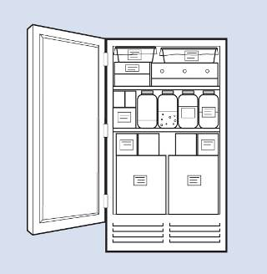
Refrigerated Storage Guidelines
Do not overload refrigerators
Storing too many products:
  Prevents good airflow
  Makes units work harder
  Never place hot food in refrigerators
Overloaded refrigerator

Slide 43
Refrigerated Storage Guidelines
Keep refrigerator doors or container utilized as refrigeration (i.e. cooler with ice) closed as much as possible
  Frequent opening lets warm air inside

Slide 44
Section 5: Food Service

Slide 45
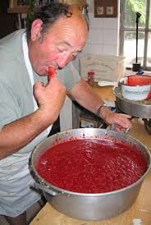
Proper Ways to Serve Food
To prevent contamination when serving food:
  Use clean and sanitized utensils for serving
    Use separate utensils for each food
    Clean and sanitize utensils after each task
  Use serving utensils with long handles to keep hands away from food
  Practice good personal hygiene
Notes:
Instructor Notes
Utensils should be cleaned and sanitized at least once every four hours during continuous use.
Proper handwashing is essential to keep food safe.

Slide 46
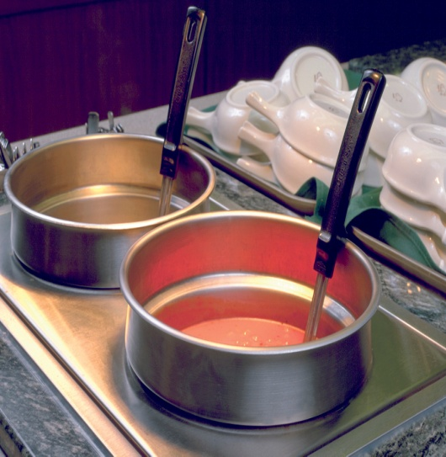
Proper Ways to Serve Food (con’t.)
To prevent contamination when serving food:
  Store serving utensils properly
    Store them in the food, with the handle extended above the rim
    of the container
    Store them on a clean, sanitized
    food-contact surface
Notes:
Instructor Notes
Spoons or scoops used to serve food such as ice cream or mashed potatoes can be stored under running water.

Slide 47
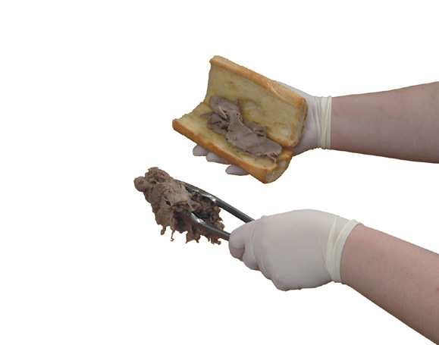
Proper Ways to Serve Food (con’t.)
To prevent contamination when serving food:
  Minimize bare-hand contact with cooked or ready-to-eat food
    Handle food with tongs, deli sheets, or gloves
Notes:
Instructor Notes
Bare-hand contact is allowed in some jurisdictions if the establishment has written policies and procedures on employee health, handwashing, and other hygiene practices. Check with your regulatory agency for requirements in your jurisdiction.

Slide 48
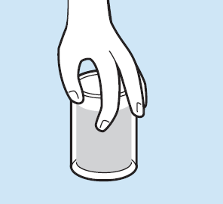

Serving Food Safely: Servers
WRONG RIGHT
WRONG RIGHT
WRONG RIGHT
WRONG RIGHT
Handling dishes, glassware, disposable food containers, plastic utensils, etc.
Notes:
Instructor Notes
Dishes and glassware should be handled properly.The food-contact areas of plates, bowls, glasses, or cups should not be touched. Dishes should be held by the bottom or the edge. Cups should be held by their handles, and glassware should be held by the middle, bottom, or stem.
Glassware and dishes should not be stacked when serving. The rim or surface of one item can be contaminated by the one above it. Stacking china and glassware also can cause them to chip or break.

Slide 49
Section 6: Cleaning it up

Slide 50
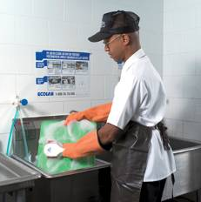
Cleaning Vs. Sanitizing
Cleaning
  Process of removing food and other types of soil from a surface
Sanitizing
  Process of reducing the number
  of microorganisms on a clean surface
  to safe levels
  Surfaces must first be cleaned and rinsed before being sanitized
Notes:
Instructor Notes
To be effective, cleaning and sanitizing must be a two-step process. Surfaces must first be cleaned and rinsed before being sanitized.

Slide 51
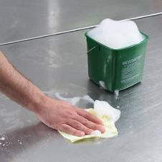
Cleaning and Sanitizing Food-Contact Surfaces
Food-contact surfaces must
be washed, rinsed, and sanitized:
  After each use
  Anytime you begin working
  with another type of food
  After a task has been interrupted and the items may have been contaminated
  At 4-hour intervals if the items
  are in constant use
Notes:
Instructor Notes
Everything in your operation must be kept clean; however, any surface that comes in contact with food, such as knives, utensils, and cutting boards, must be cleaned and sanitized.

Slide 52
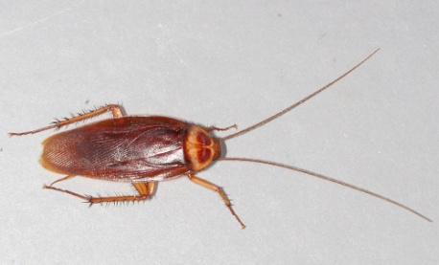
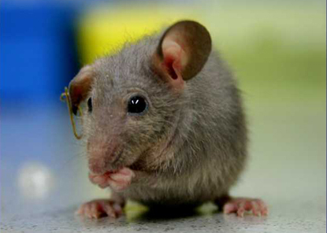
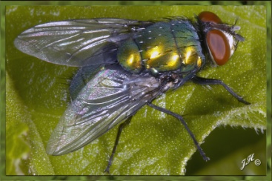
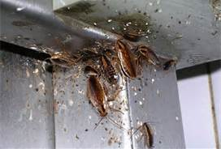
PESTS

Slide 53
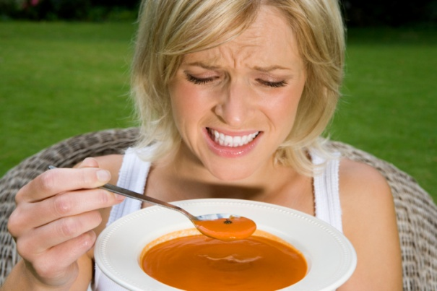
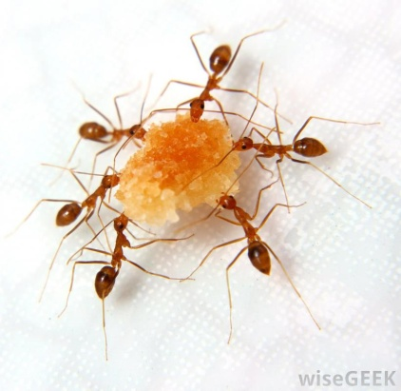
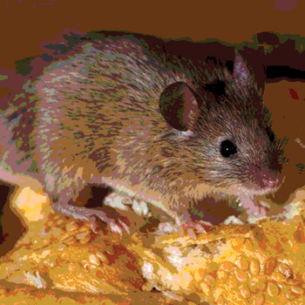
Where are they typically found?
Idle Equipment
Soft drink syrup cabinet
Steam table and salad bar
Behind Kick plates
Ice maker/cooler
Dishwasher
Floor Drains
Dining Room Booths
Planters
Tray Racks
Trash receptacles
Any place that they can find food, water, and shelter!

Slide 54
Deny them access!
Avoid pest infiltration by:
  Denying them access to your area.
    Keeping your area clean.
    Clean up food debris from areas where food is served (to include off the ground).
    Clean and monitor areas most susceptible to pests.
    Dispose of garbage quickly.
    If utilizing garbage receptacles or trash bags, ensure that the receptacles have a lid and are closed/covered when not in use.

Slide 55
SUMMARY
Foodborne illnesses are PREVENTABLE!!
Keep food out of the Temperature Danger Zone BETWEEN 41- 135 degrees Fahrenheit!
Protect food from all sources of contamination!
Practice good personal hygiene. When in doubt, wash your hands!
Ensure your thermometer is calibrated!
A helpful quick reference sheet will be attached to this slideshow to print and keep in your food service area!

Slide 56
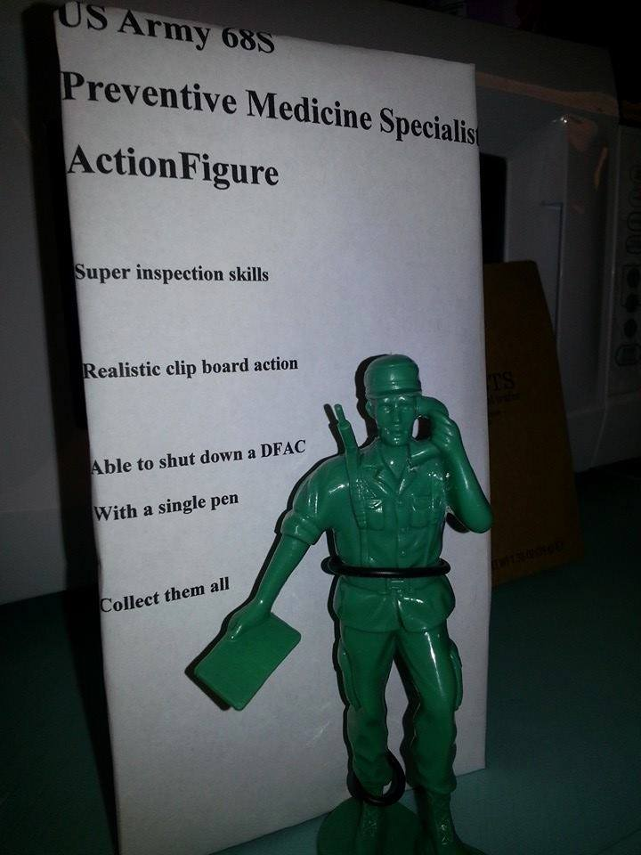


QUESTIONS/CONCERNS?
Contact :Environmental Health, TAMC Bldg 147, 1 Jarrett White Rd.
Deputy Chief of EH: LTC Derrick, David 433-9938
NCOIC of EH: SGT Renihan, Morgan 433-6694

